Slide 1
Park safe
Progress Update – 21/11/18
Team - 10

Slide 2
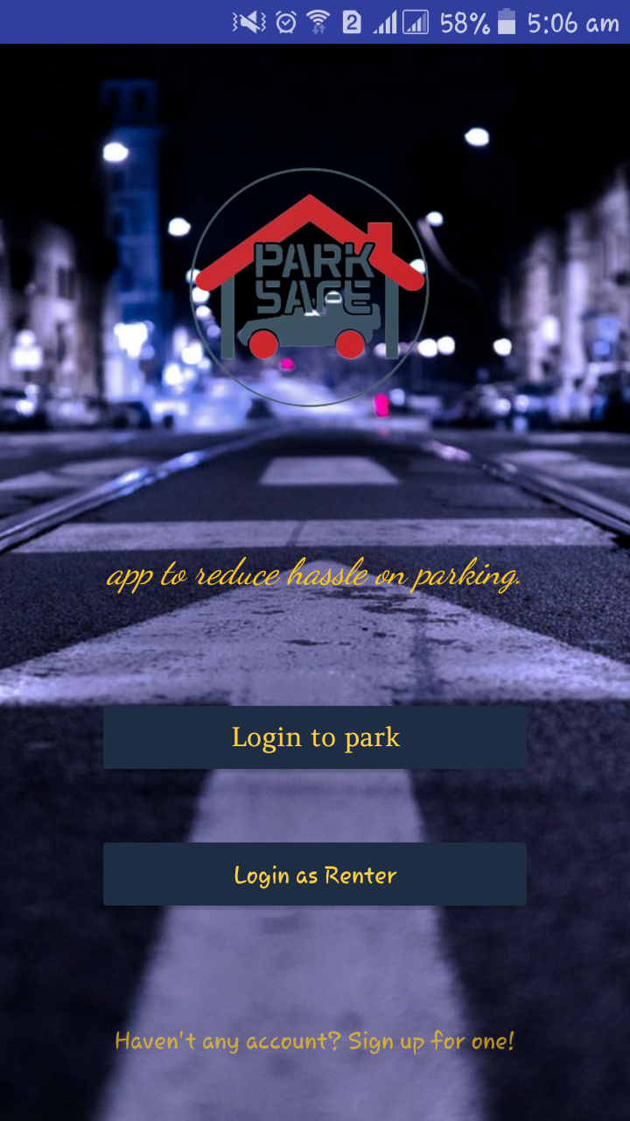
Home page / welcome page
Purpose of this page:
As we proposed earlier, our system consists of two separate side, one for Renter and one for User/Driver.
Login to park- connects to login Driver activity for sign in purpose.
Login as Renter- connects to login Renter for sign in.
Haven’t any account – transparent text will connects to signup for Driver only. For security purpose, we let the driver/user to sign up.
However, secure sign up process for renter isn’t introduced yet.

Slide 3
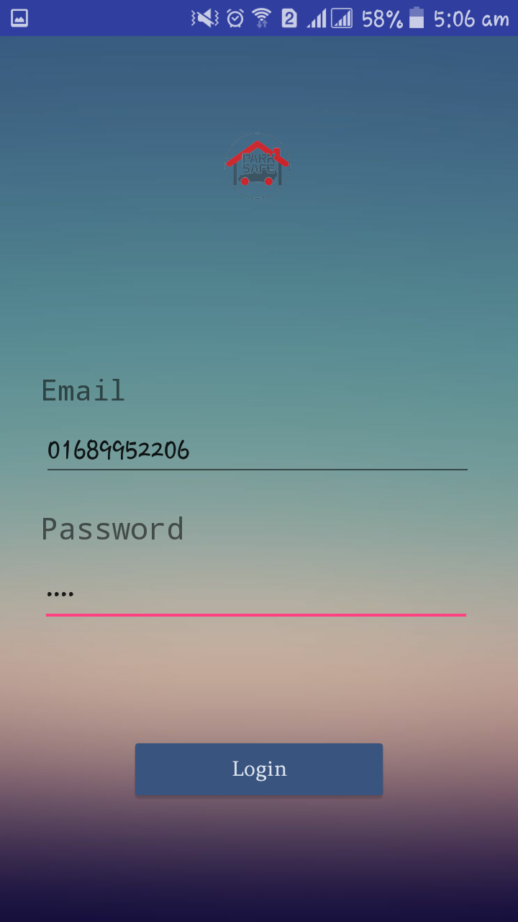
Driver login activity
Regular sign in layout for driver,
For sign in purpose it will take Mobile number (unique means no common phone number, one number for one account only), and password provided by user
On click Login button, it connects to database hosted on remote domain raktimprova.apps19.com, and on success connects to map activity.

Slide 4
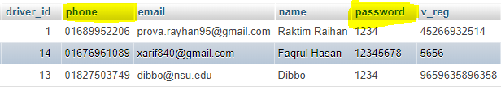

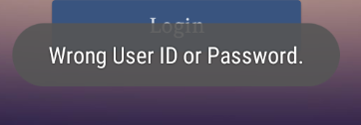
Data verification
Driver table
Renter Table
On login process user will be checked with phone and password, on match next activity will be started.
Here, phone is unique entry, driver/renter_id primary key (Auto increment).
All data will be accessed with driver_id/renter_id from respected table.
On failure to login system will display a toast.
Stays on the same page

Slide 5
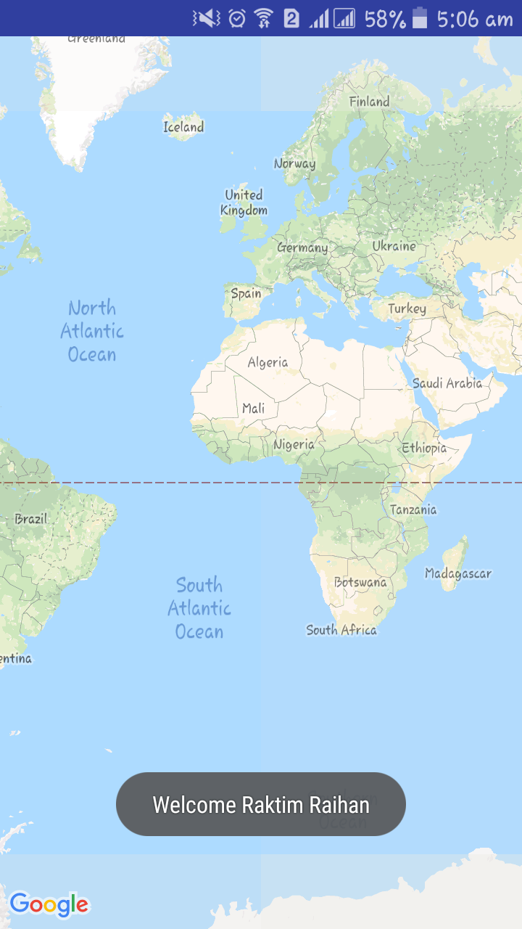
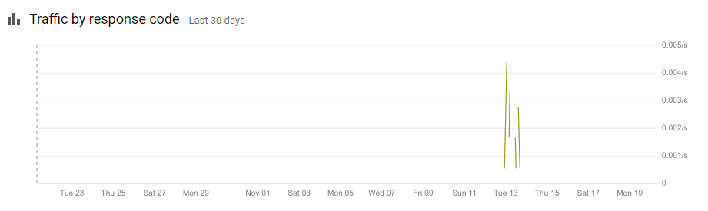
On login process
On successful login, a pop-up will be shown with welcome message for each user.
Behind the screen, GPS will start to locate user’s location.
For tracking we used google map API.
Generally it takes 10-12 seconds on bad network from verifying to locate.

Slide 6
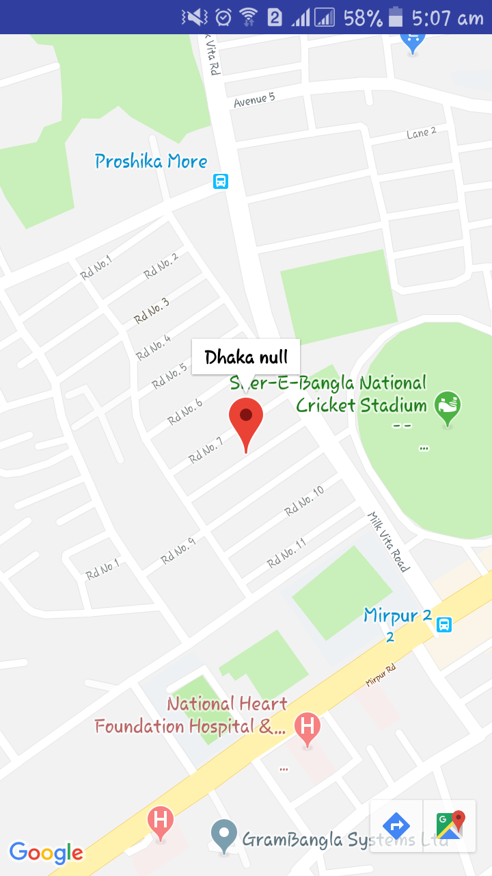
User’s current location, with camera set focus/zoom to 20x.
On click location marker on map, user’s location will be viewed preciously. However, exact location name can’t be fetched using API sometimes. On this case null is displayed followed by city name.
All information can be transferred Eg, current location, and destination to Google Map

Slide 7
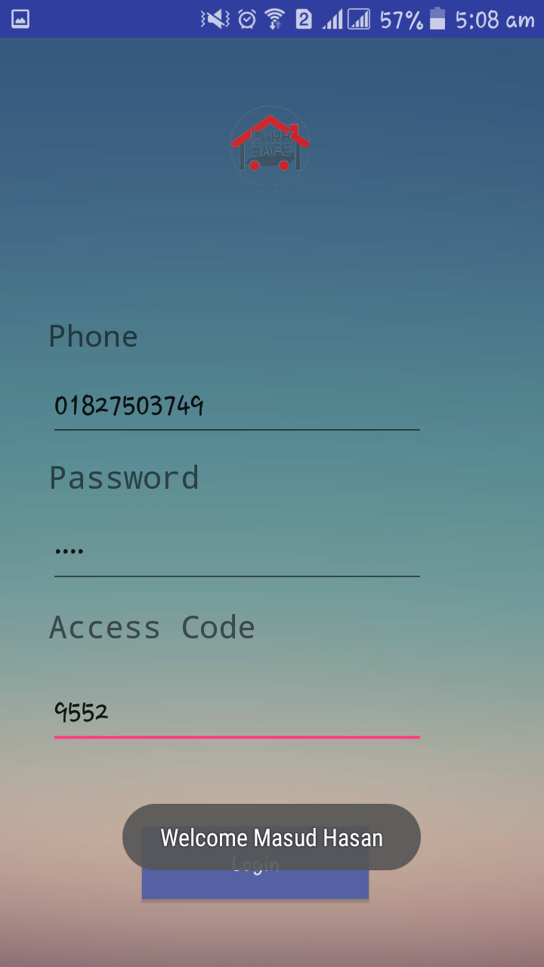
Renter Login Layout
Primarily renter will be verified using phone, password, and unique access code provided before.
On success login process, Welcome message will be appear, and control will transfer to the next activity.

Slide 8
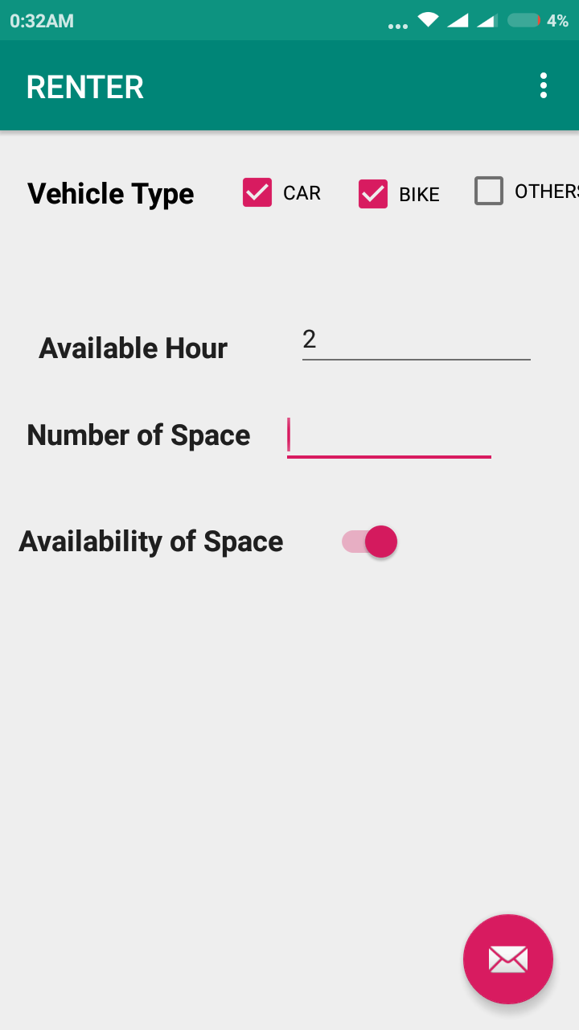
Review parking space
Before make the space online, renter will customize each time according to his needs
Type of Vehicles,
Available hour,
Number of Parking Space Available.
On clicking radio button, this parking space will be available to rent.
And connect to next page.

Slide 9
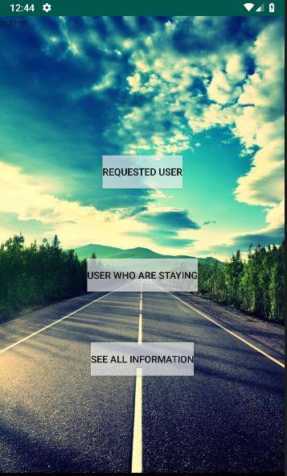
Renter’s interface
Rented user: This button will refer to list of user who have requested for this place but haven’t arrived yet, hence they are about to come.
Staying users: connect to layout of containing list of parked vehicle information. For here, renter can view any user’s session status and total fare to be collected. These lists will be read-only.
See all information: renter can view his all information to whom he has already served.

